Slide 1
Robotic Arm
Supervisor: Dr/Fatma Elfouly
Team Members
Mohamed Ashraf Gouda
Mohamed Sabry Mohamed
Mustafa Mahmoud Shafeeq
Mohamed Mourad Ramadan
Mohamed Yehia Ahmed
Nasser Alaa Eldein Ibrahim

Slide 2
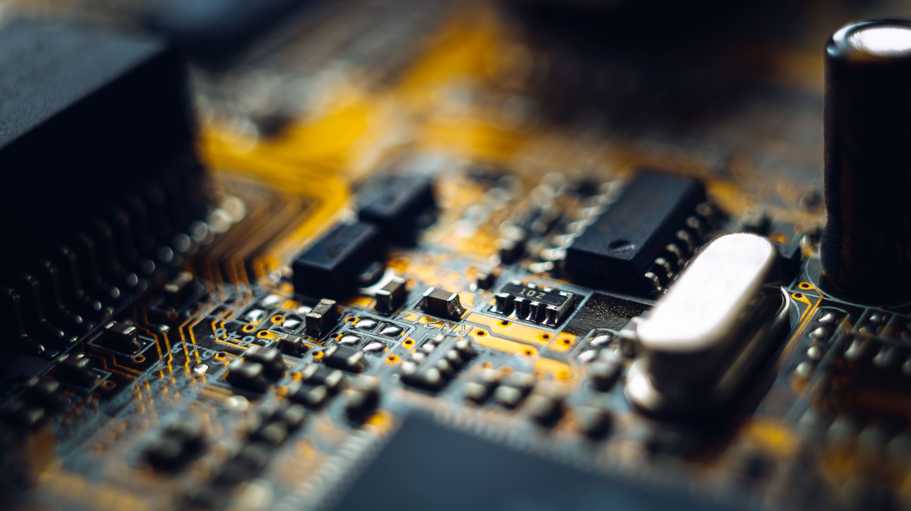
Robotic Manipulator

Slide 3
Outlines
Motivation
Problem description
Problem solution
Introduction
Hardware
Software
Future plans

Slide 4

Motivation

Slide 5

Problem Description
People with physical disabilities can not reach for objects.

Slide 6
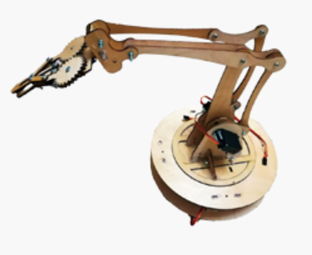
Problem Solution
We will solve these problems in the following steps:
We will make a robotic arm to help them for bringing the object.
Voice Recognition system let them send commands by voice.
The voice input will be via Bluetooth.

Slide 7

Introduction
The robotic arms are used in a widely spectra of helping disabilities, to let them do daily routine easily .

Slide 8
Project block diagram
S/W
H/W
camera
LCD
Mobile
application
controller
Bluetooth
module
Catching and delivering object
Arm moving
and detection

Slide 9

Hardware

Slide 10
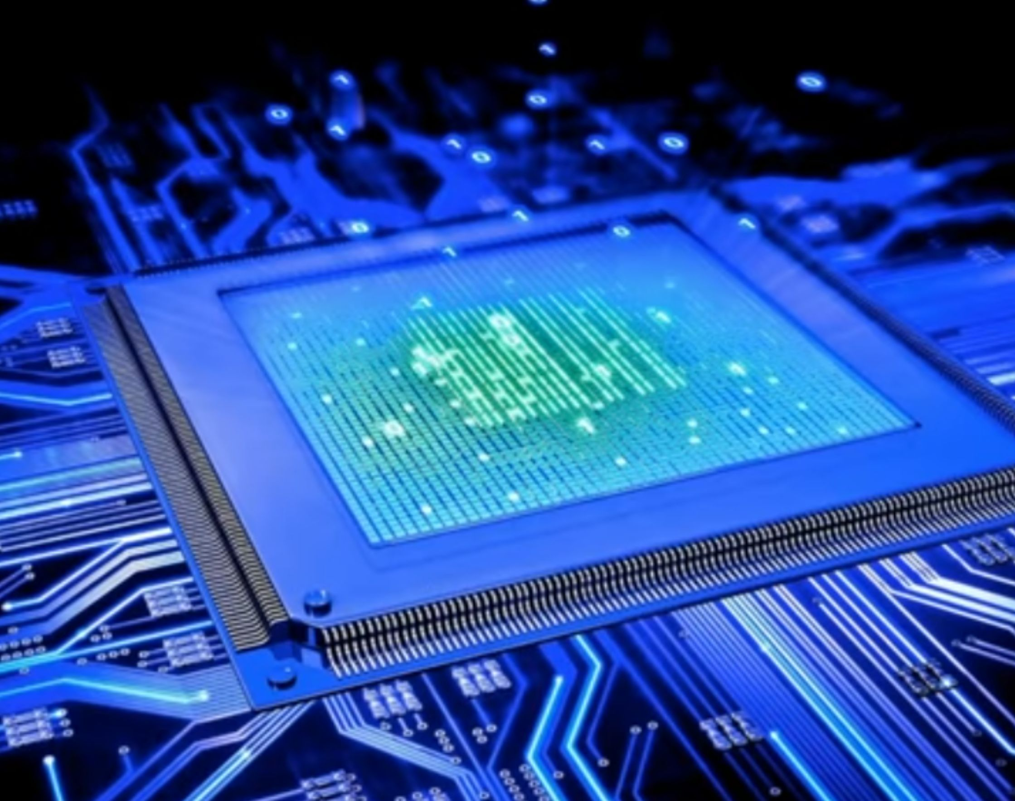
Controllers
ATMEGA 32
Raspberry pi 3B

Slide 11
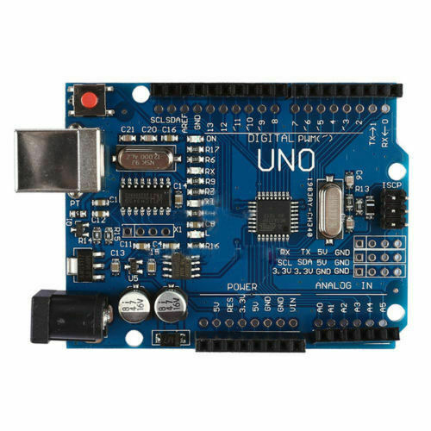
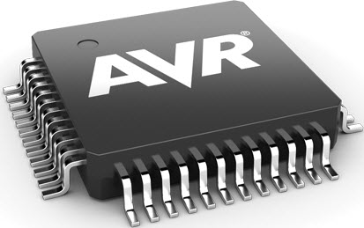
Avr microcontroller vs Arduino
Terms | AVR | Arduino
Cost | Cheap cost | Expensive cost
Coding | From scratch | Easy code
Microcontrollers | ATmega (16,32,128,328) | AVR (Atmega-328P)
Manufacturing | Direct usage | Can’t use Arduino board
Coding | One time code | Many times
usage | Execute last code | Editing phase

Slide 12
AVR Microcontrollers
Terms | Atmega 16 | Atmega 32 | Atmega 64
Program memory | 16K | 32K | 64K
SRAM | 512 | 2048 | 4096
Timers | 1*8 bit 1*16 bit | 2*8 bit 1*16 bit | 2*8 bit 1*16 bit
EEPROM | 512 | 1024 | 2048
USART | Yes | Yes | Yes
I/O ports | 32 | 32 | 32
Oscillator | 8M | 8M | 16M

Slide 13
ATMega32 Kit

Slide 14

Microcontroller Layers

Slide 15
APP
(application)
HAL
(Hardware Abstraction Layer)
MCAL
(Microcontroller Abstraction layer)

Slide 16

Flow Chart

Slide 17
Start
Get input from App
No object
Check if text is headache
Y
N
Move to Patient
Check headache
In slots
N
Y
catch

Slide 18

Raspberry Pi

Slide 19
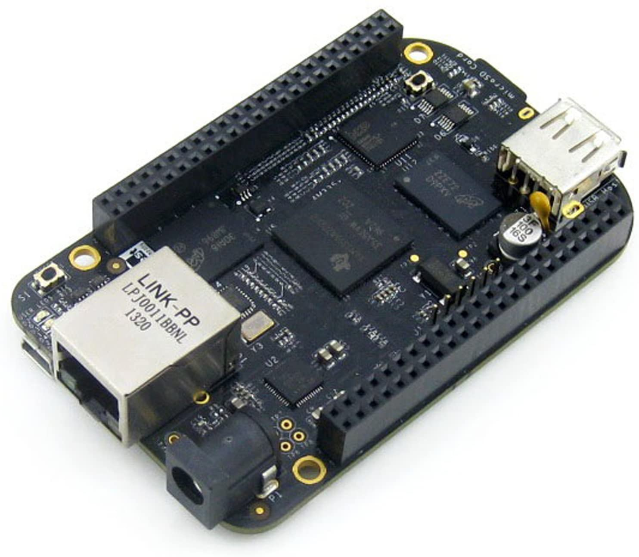
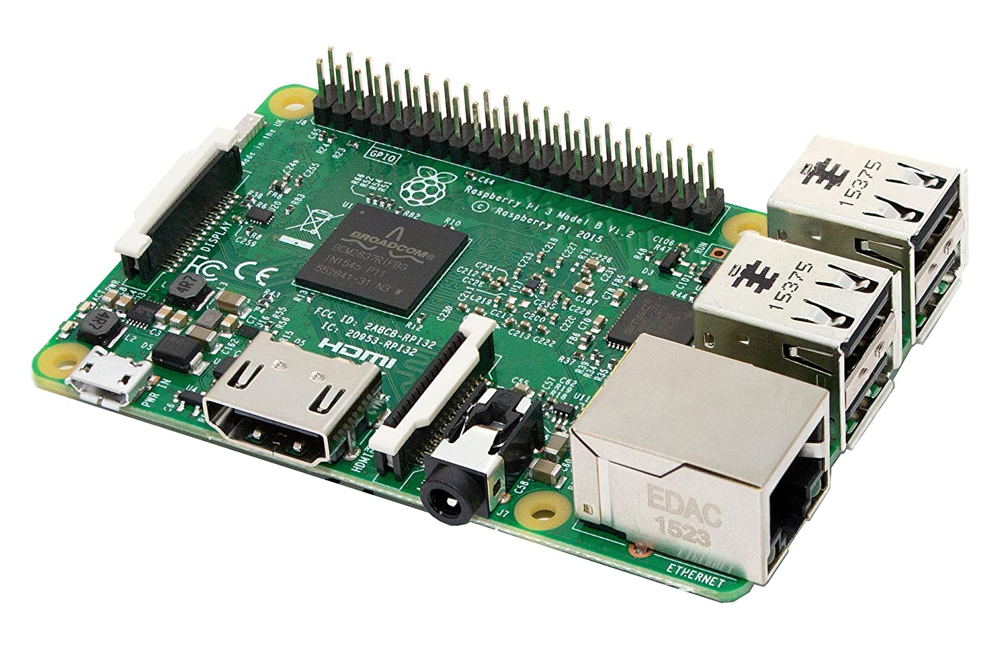
Comparison between raspberry pi and BeagleBone Black (BBB)

Slide 20
Comparison between raspberry pi and BeagleBone Black (BBB)
BeagleBone Black (BBB) | Raspberry pi | Terms
Low Community support | More Community support | Community support
High | Low | Cost
High | Low | Power

Slide 21
Types of Raspberry Pi Boards
Raspberry Pi B
Raspberry Pi 2
Raspberry Pi 3

Slide 22
Comparison between Raspberry Pi boards
Raspberry pi 3 | Raspberry pi 2 B | Raspberry pi 1 | Terms
4 | 4 | 2 | USB 2.0 ports
Exist | None | None | Bluetooth
Exist | None | None | Wi-Fi
10 times more than pi 1 | moderate | slow | Speed

Slide 23
Raspberry Pi 3 B

Slide 24
Flow chart
Stand By
Take an Image Frame
Object Detection
YES
Is Color detected ?
NO
Object Track
Move Arm

Slide 25
RGB Detection Using Raspberry pi

Slide 26
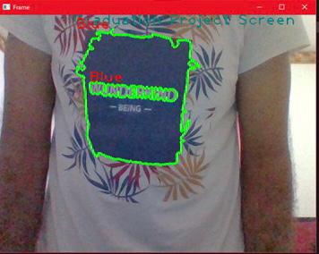
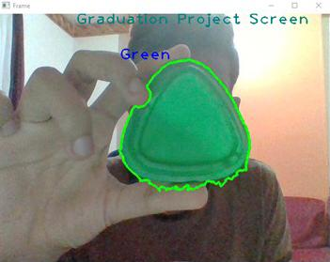
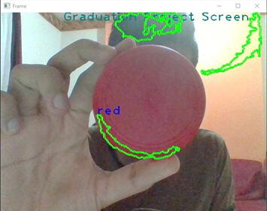

Slide 27
MCAL

Slide 28
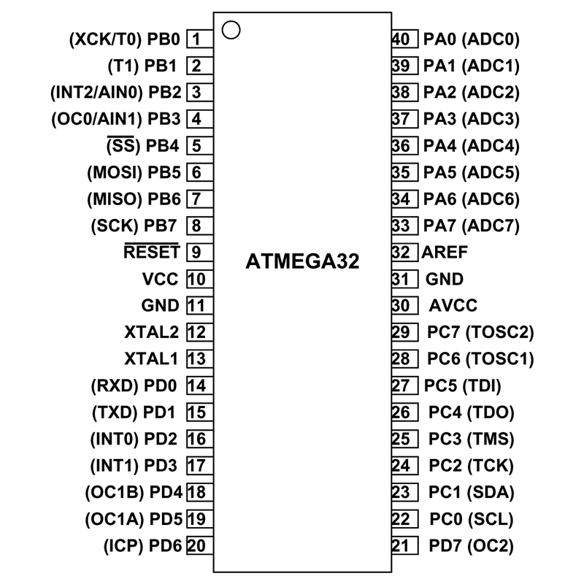
MCAL

Slide 29

Interrupts

Slide 30

Block Diagram

Slide 31
Interrupts
Hardware Interrupts
Software Interrupts
(INT n)
Maskable Interrupts
Interrupts
256 Types of software interrupts

Slide 32
Interrupts Software
Used by operating system to provide hooks into various functions.
Used as a communication mechanism between different paths of the program.

Slide 33
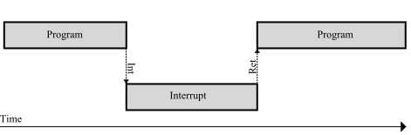
How Interrupts happen

Slide 34

USART

Slide 35
USART Register
Control register
Transmit
Receive
FIFO control
Status
Interrupt
Interrupt enable
Format control

Slide 36
HAL

Slide 37
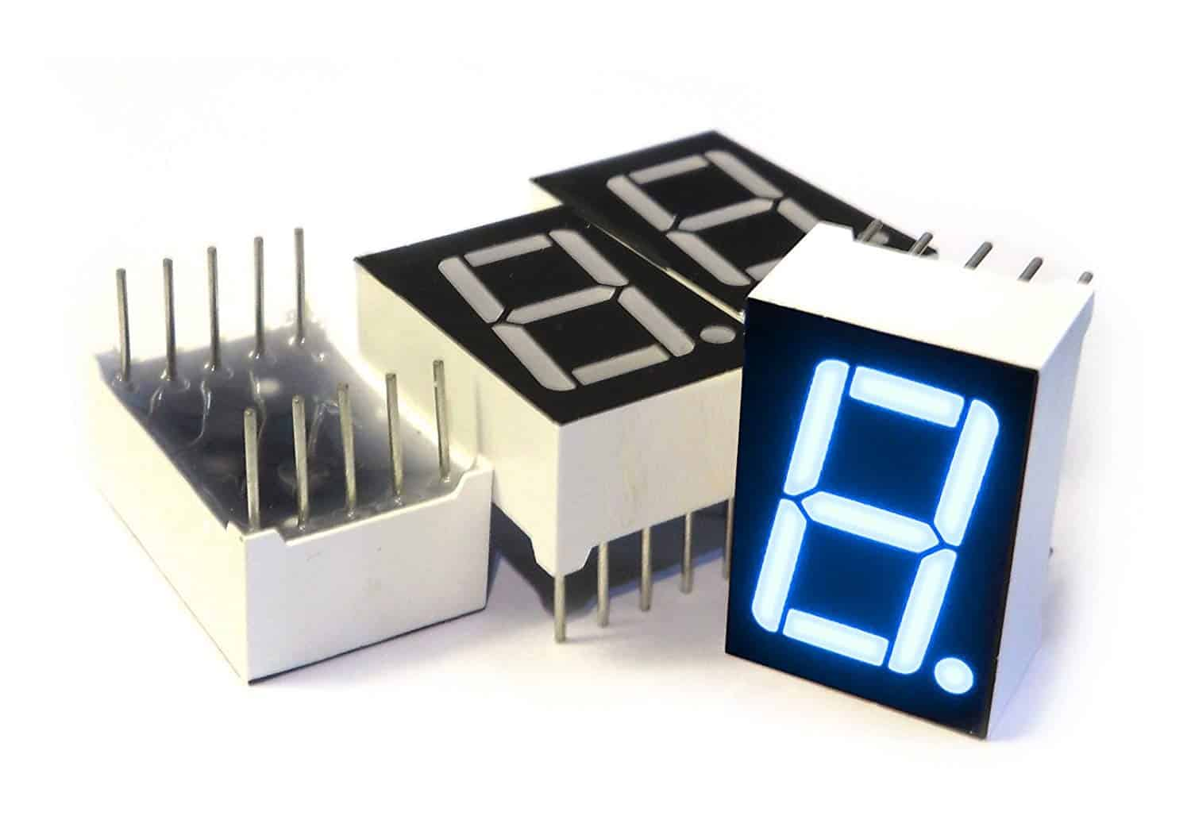
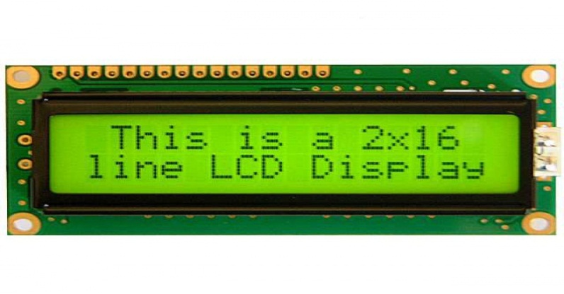
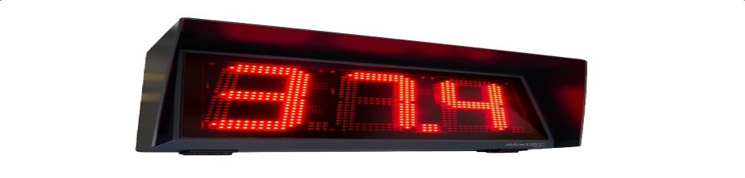
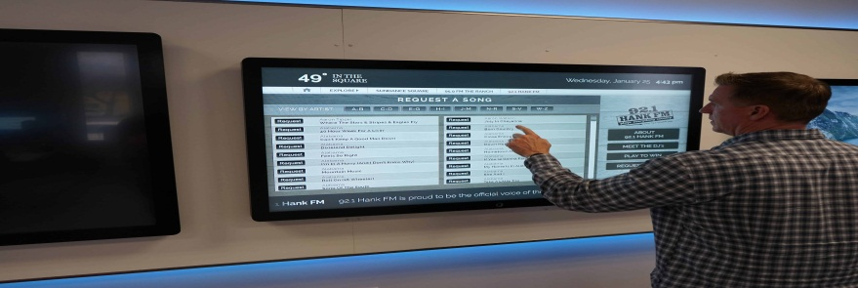
Types of display

Slide 38
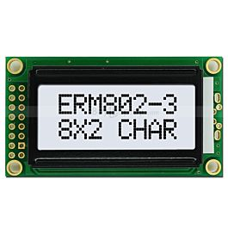
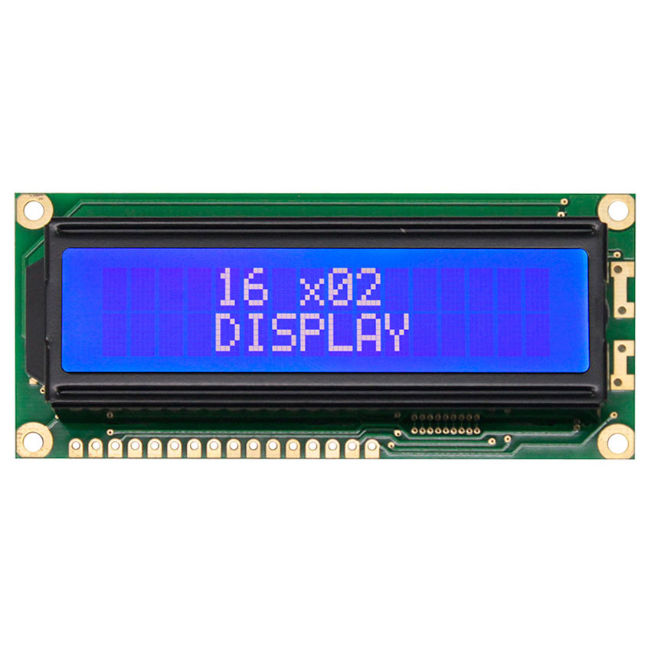
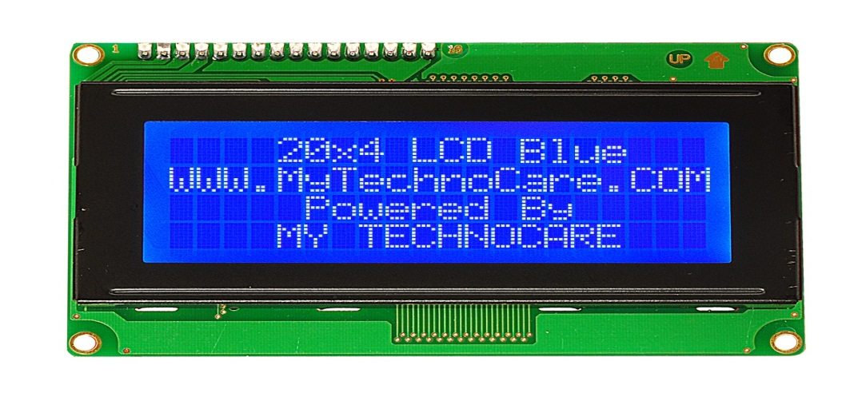
Types of LCD Display

Slide 39
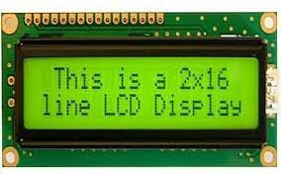
LCD

Slide 40

Timers

Slide 41
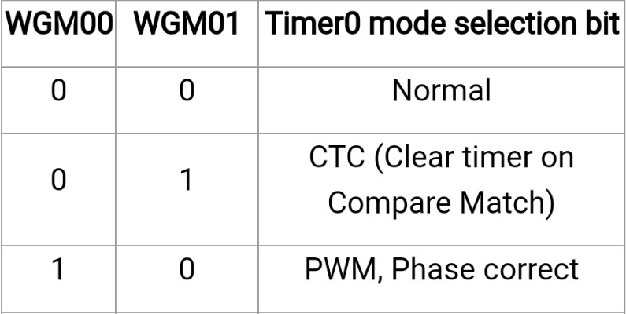
Timers

Slide 42
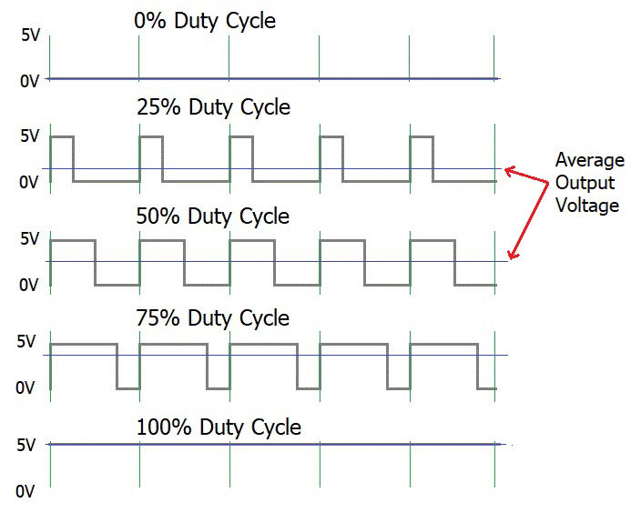
Pulse Width Modulation

Slide 43
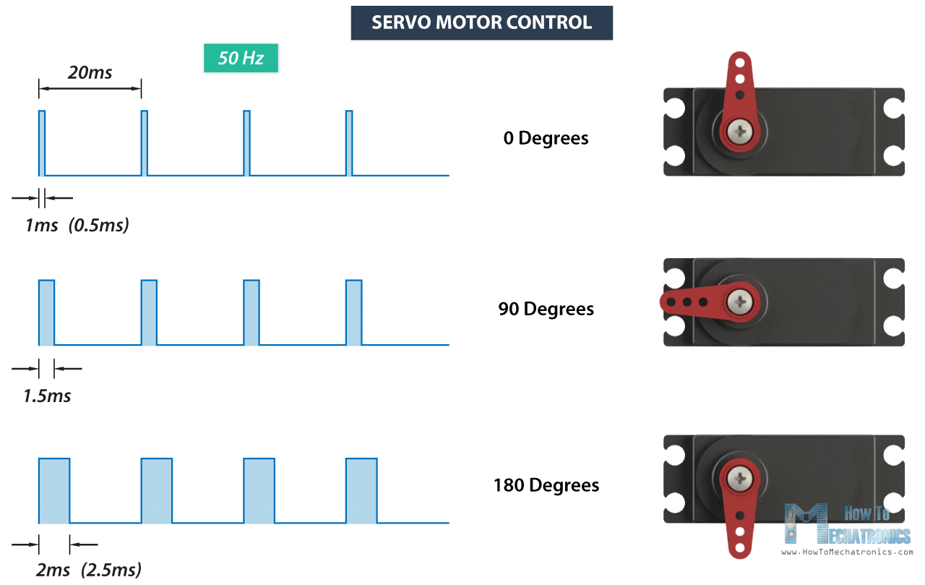
Interfacing Servo Motor with ATMEGA 32

Slide 44

Servo Motor

Slide 45
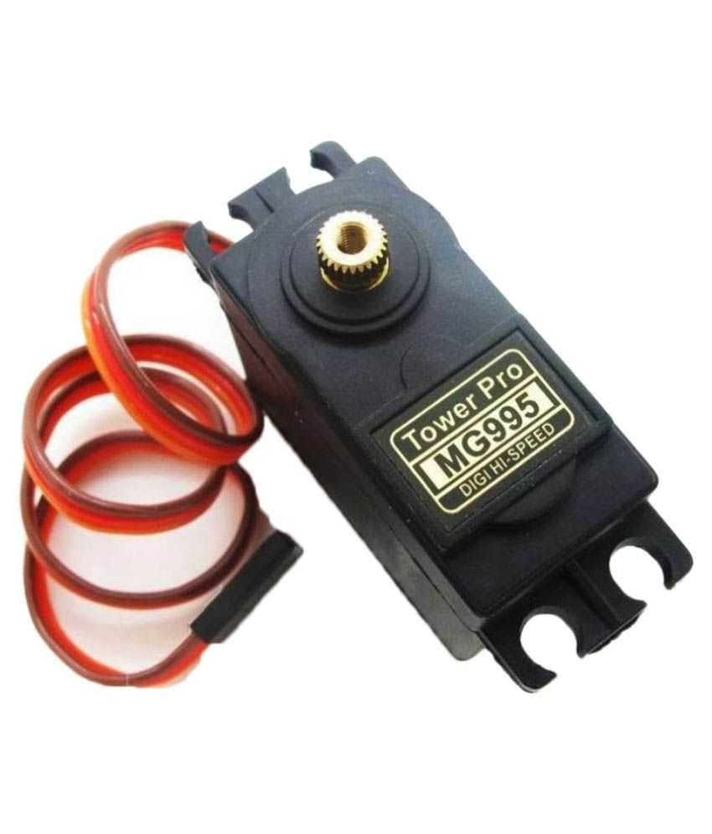
Servo Motor

Slide 46
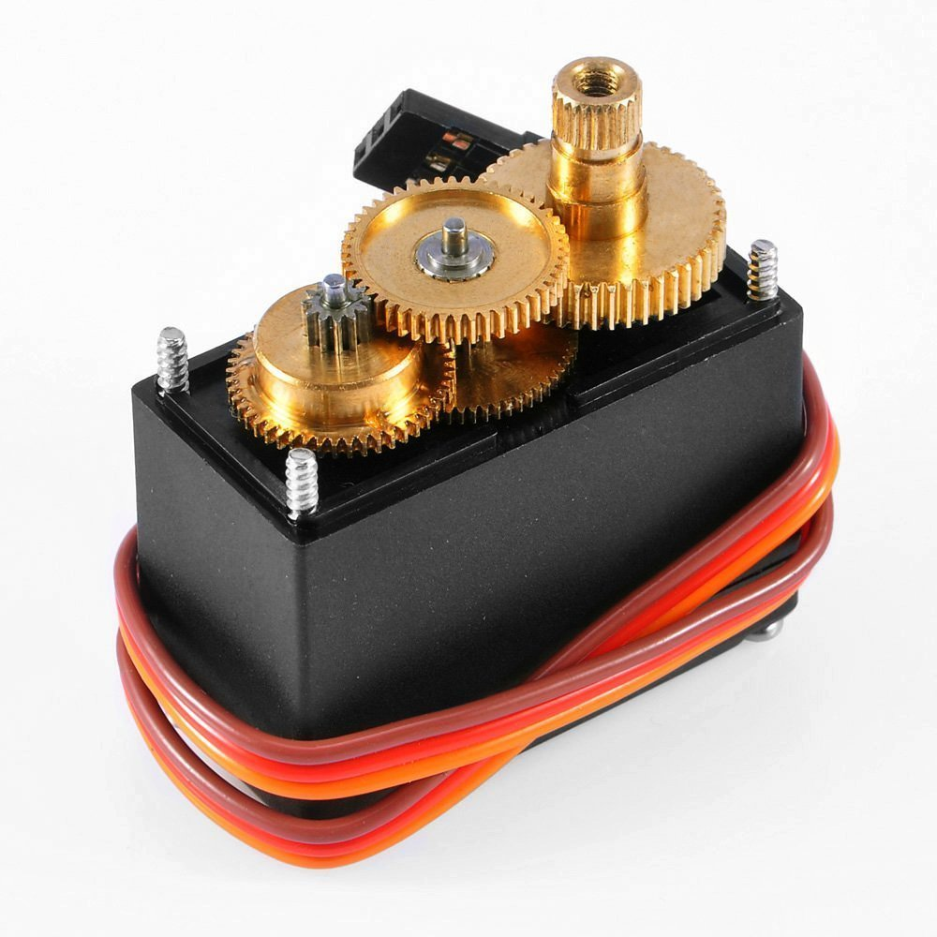
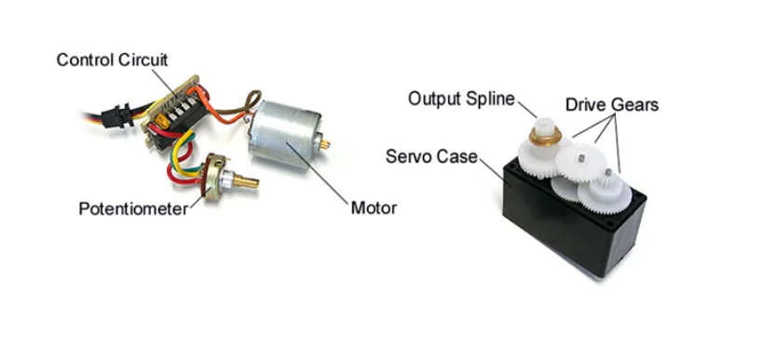
Internal Components

Slide 47
Comparison between SG90 and S3003
Servo motor sg90 | Servo motor s3003
Torque 2 kg/cm | Torque 3.17 kg/cm
Speed 0.09s/60° | Speed 0.23 sec/60°
Gear type plastic | Gear type Plastic
Rotate angle 180° | Rotate angle 60°

Slide 48
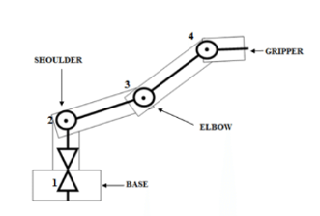
Mechanism of Robotic Arm

Slide 49
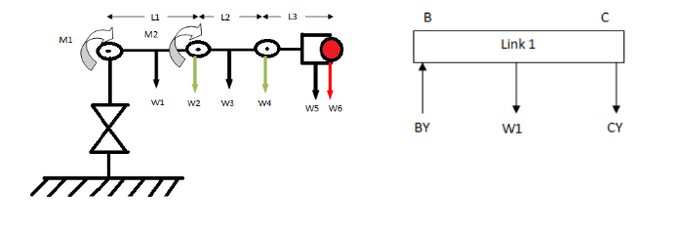
View of loads/moments on joints (right) and force diagram

Slide 50

View of loads/moments on joints (right) and force diagram
$$T=F×L Nm$$

Slide 51
Types of Robotic Manipulator
Articulated robot.
SCARA robot
Cartesian robot
Parallel or delta robot

Slide 52
Body of Manipulator

Slide 53
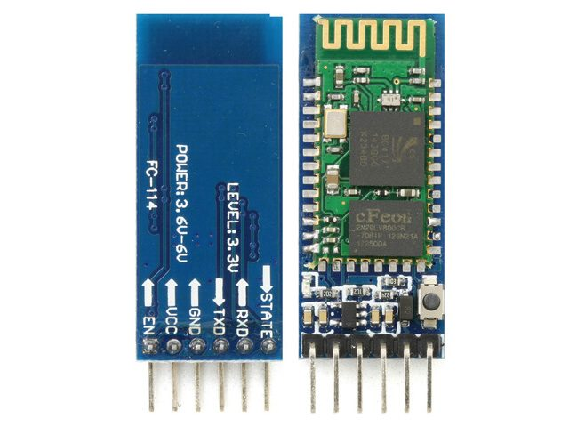
HC 05 Bluetooth Module

Slide 54

Software

Slide 55

Mobile Application

Slide 56
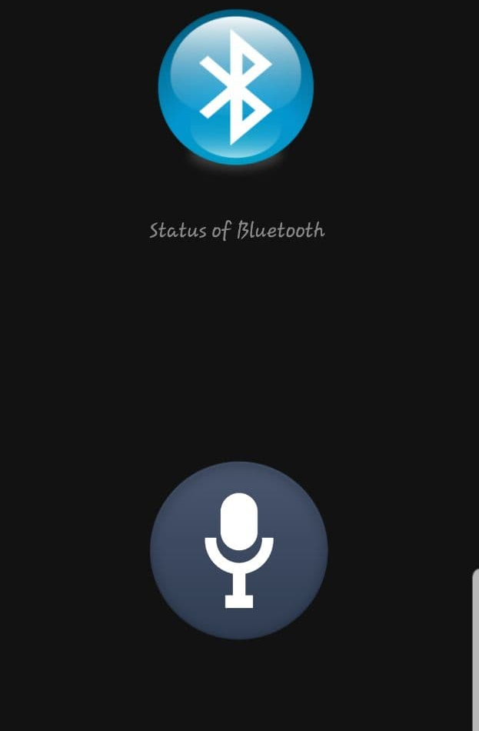
Mobile Application Design
It consists of two icons:
Bluetooth Icon: ON/OFF
MIC Icon : to give the command

Slide 57
Programming Tools

Slide 58

Android Studio

Slide 59
Most Familiar Programming Tools
Eclipse | Android Studio | Terms
Slower | Faster | Execution Speed
Not exist | Exist | AVD Manager
Not exist | Exist | Code editing Flexibility

Slide 60
Implementation

Slide 61
Activity Launched
onCreate()
Check MAC Address
N
Y
onStart()
Activity Running
SentHC05()
onDestroy()
getSpeechInput()

Slide 62

Flow Chart

Slide 63
Start
Activation of Bluetooth smartphone
Choose and connect Bluetooth
Get Voice from Google Speech
Password pairing
Send data to Bluetooth from user
N
Correct Password 1234?
Send Data to micro-controller
Y
Connect with HC-05
Y
N
End
Check connection
Bluetooth connected

Slide 64
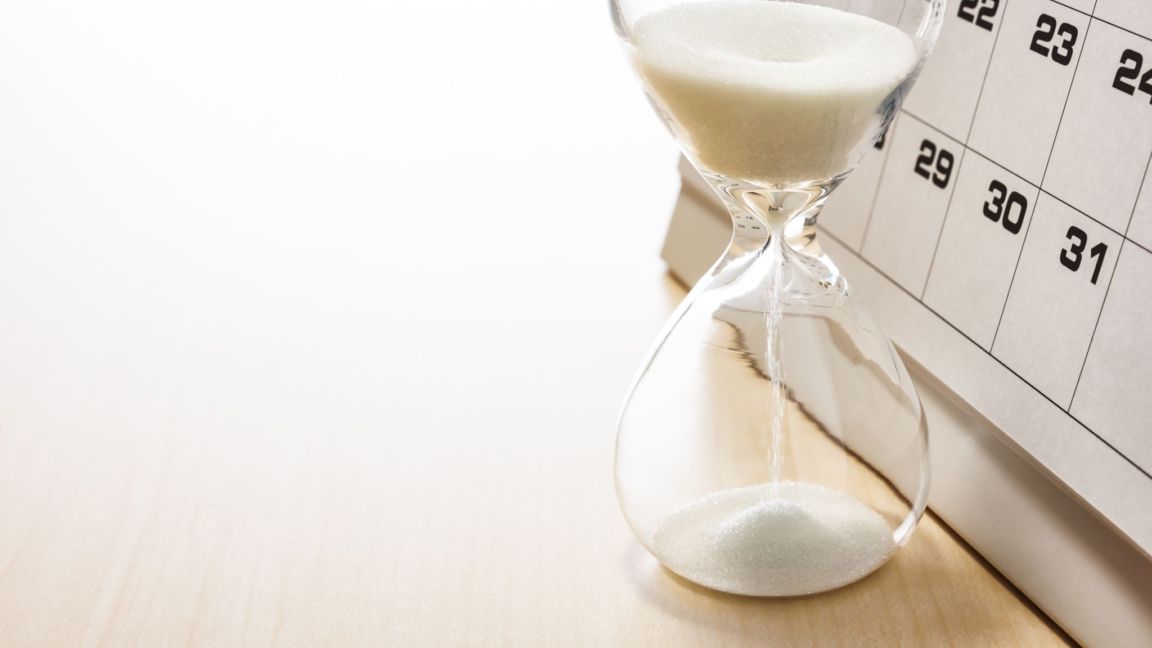
Project Timeline

Slide 65
T I M E L I N E S L I D E
Embedded C Code
Mobile App Code & Design
Raspberry Pi Code
Sep-Dec
Apr-May
July-Aug
Dec-Apr
May-June
Gathering information
Choosing idea
Collecting Arm Hardware and coupling with code
Future Work

Slide 66

Future Plans

Slide 67
Steps
Improve
the Robot Arm’s Material
Implement
full image processing to detect the full object even it will be medicine or another things, and can choose it between many places.

Slide 68

Any Questions ?!

Slide 69

Running Project Video

Slide 70
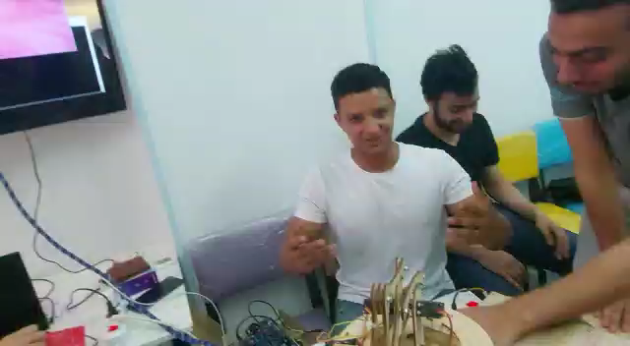

Slide 71

Thank you

